Slide 1
BIIT Attendance Management System
Supervised By:
Sir. Zahid
Presented by:
Mirza Abdullah Izhar
18-Arid-0255

Slide 2
Objectives:
An application to Manage Students Attendance.
Student can view their attendance.
Teachers can mark attendance according to their schedule.
Director can view the attendance of all students.
Message notifications would be sent to short attendance students.

Slide 3





Conceptual Diagram:
1
Web Sever
See attendance
See their schedule
Mark attendance offline or online
Request
Teacher
Response
Response
Request
Response
View & Set short attendance criteria for any class
BIIT AMS
Web
App
Response
View his/her attendance
Director
Response
DB
Student

Slide 4
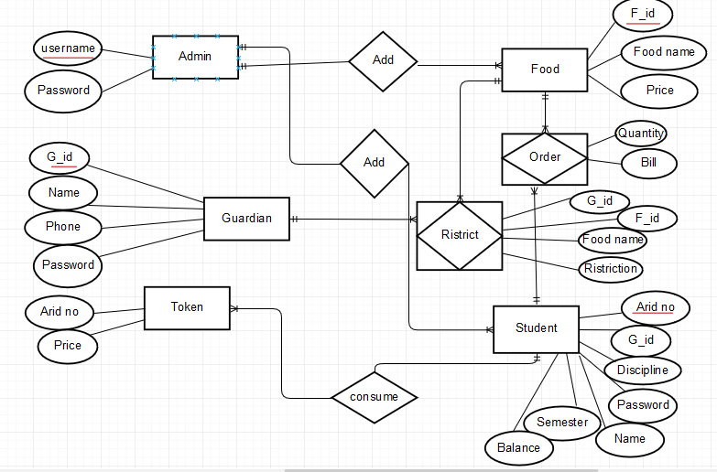
ERD:
2

Slide 5
DFD(Data Flow Diagram) Level 0
3
Request
BIIT
AMS
Director
Response
Request
Request
Response
Response
Student
Teacher

Slide 6
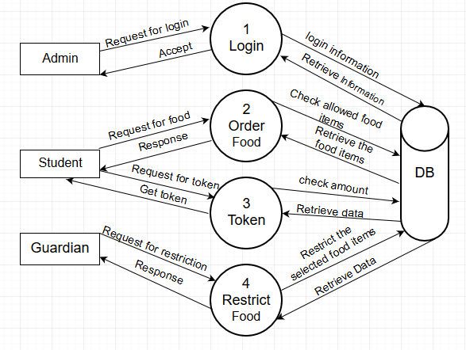
Level 1
4

Slide 7
Tools and Technologies:
5
Visual Studio Code.
Visual Studio.
MSSQL Server .
Web Service.

Slide 8
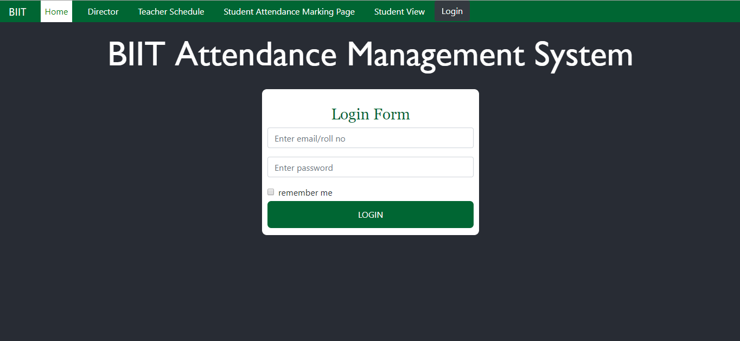
Screen Shots: (Login Screen)
6

Slide 9
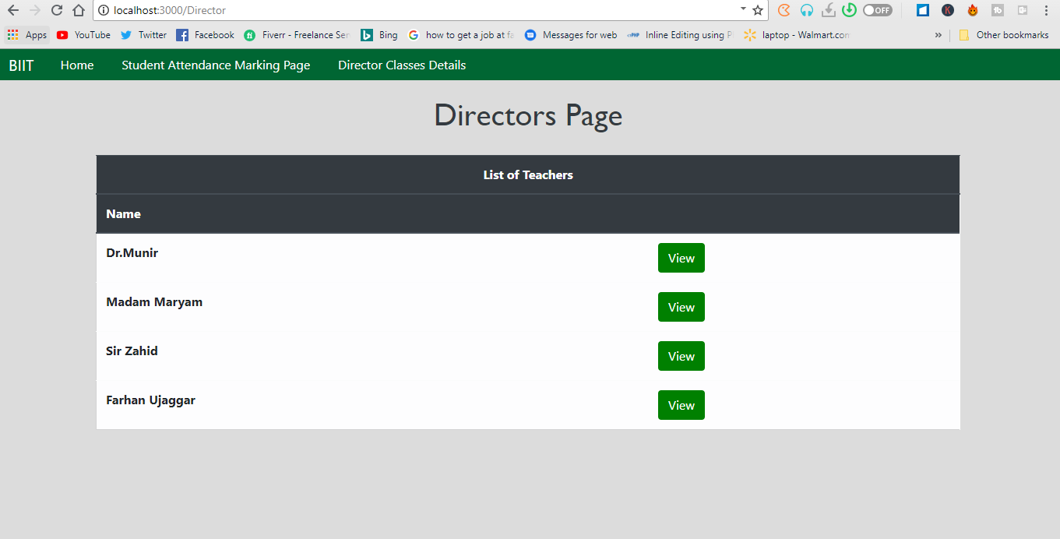
Screen Shots: (Director Screens)
7

Slide 10
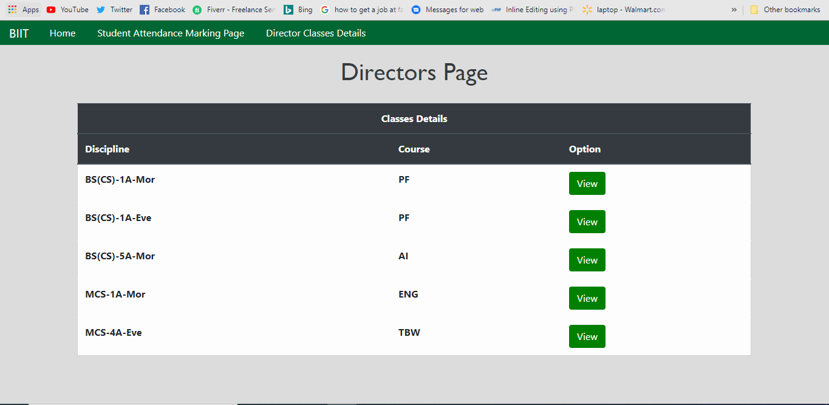
Screen Shots: (Director Screens)
7

Slide 11
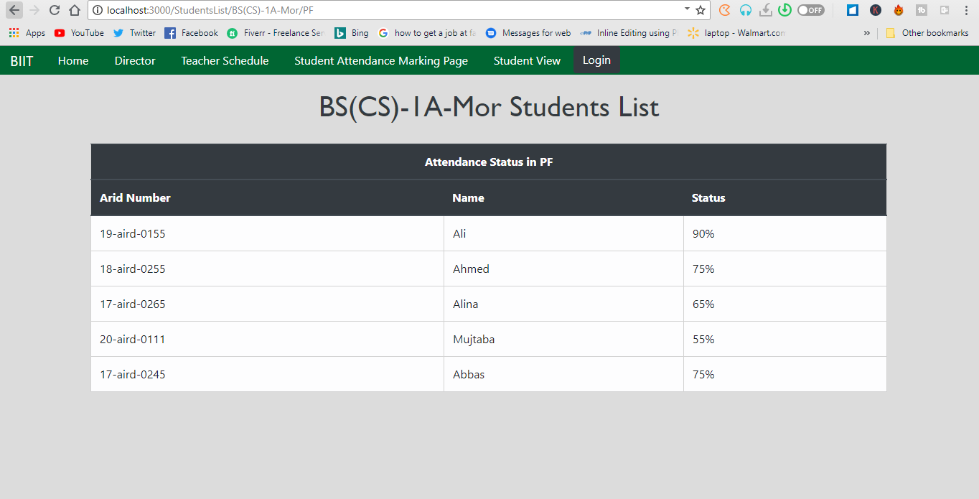
Screen Shots: (Director Screens)
8

Slide 12
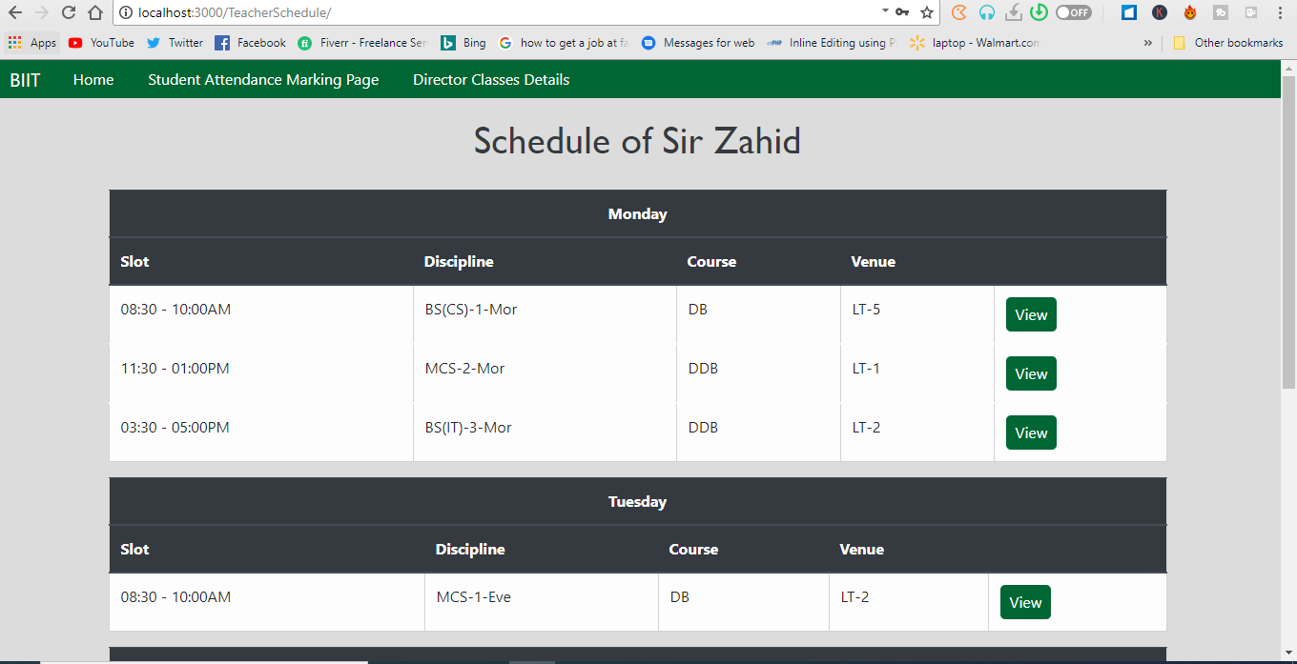
Screen Shots: (Teacher Screens)
9

Slide 13
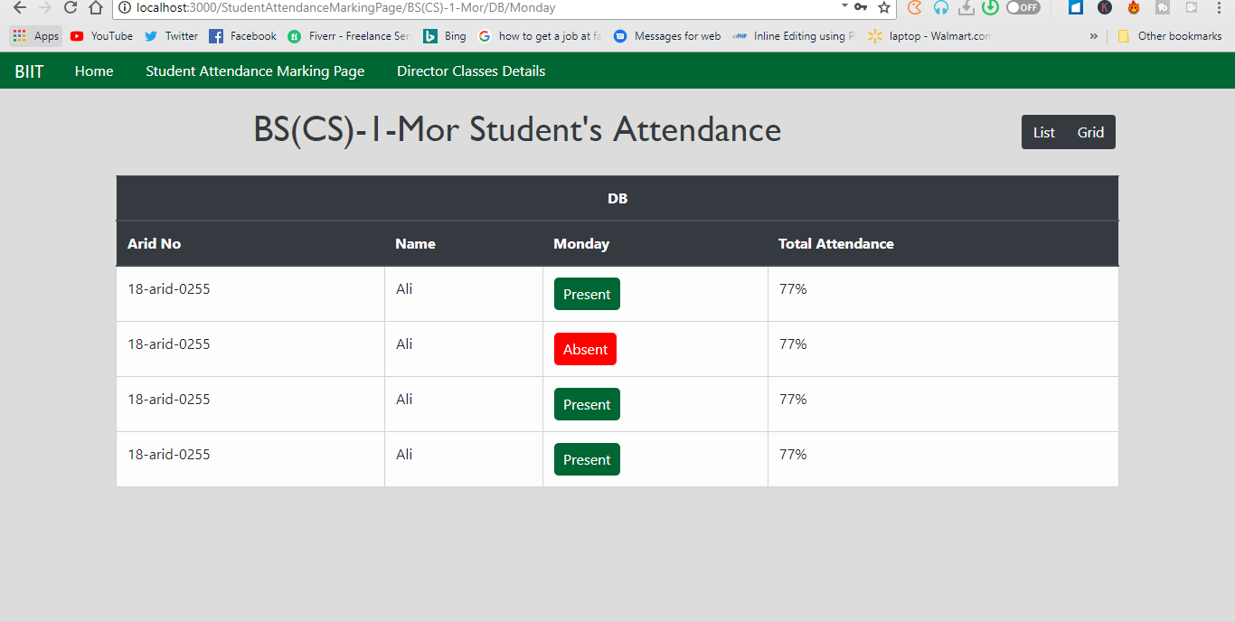
Screen Shots: (Teacher Screens)
10

Slide 14
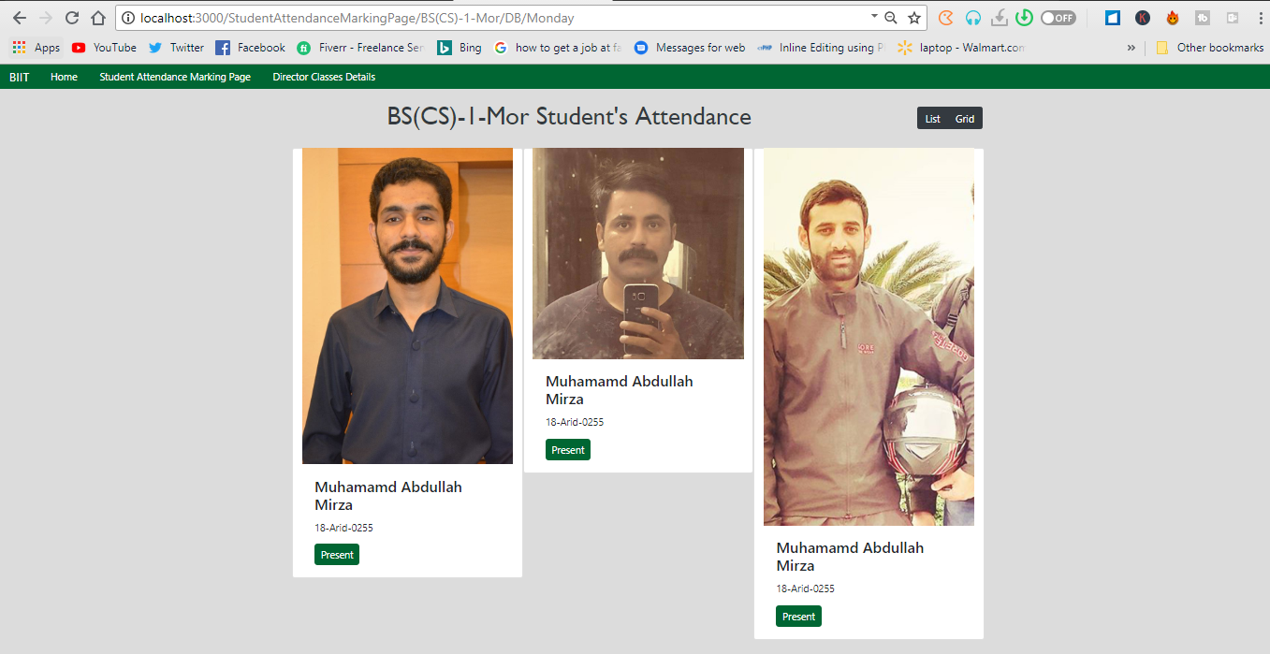
Screen Shots: (Teacher Screens)
11

Slide 15
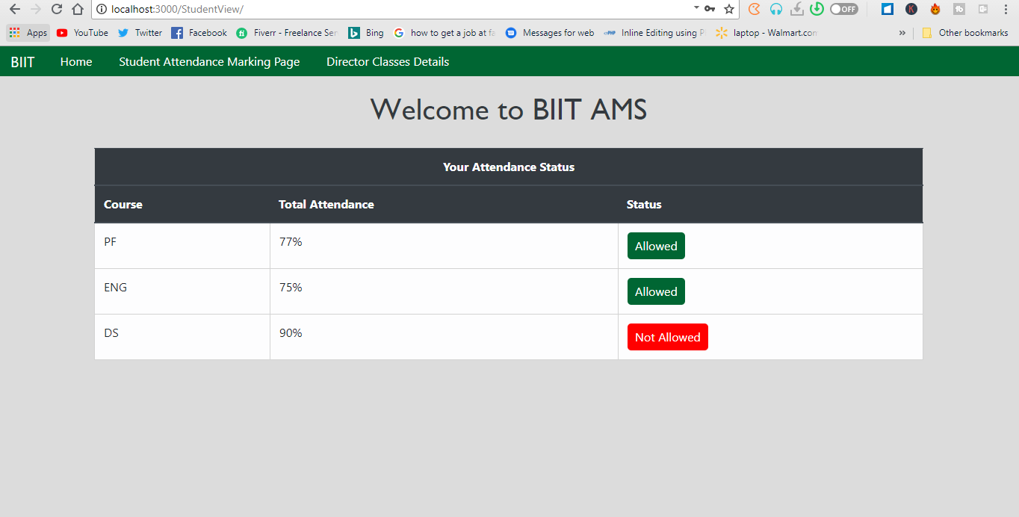
Screen Shots: (Student Screens)
12
70%

Slide 16
END

